Slide 1




Basic of C Programming
Presented by:
Group:-8
Deepak Kumar Beniya
Debasish Sahoo
Satyam Barun Nayak
Under the Guidance of
MR GOPAL SIR

Slide 2
CONTENTS
02
/18
Topic Name
Page No.
Data Types
Operators
Control Statements
Loops
Functions
Array
Pointers
Structures
3
6
9
12
15

Slide 3
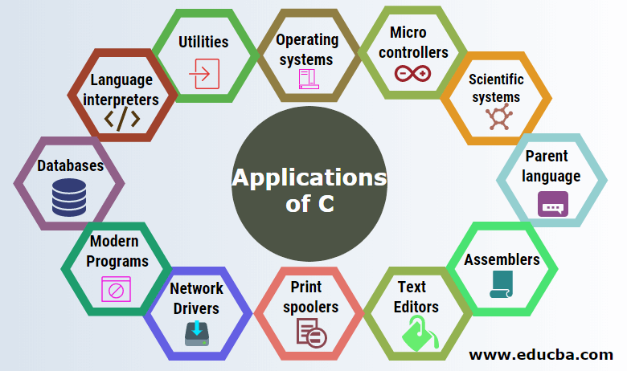
02
/18

Slide 4
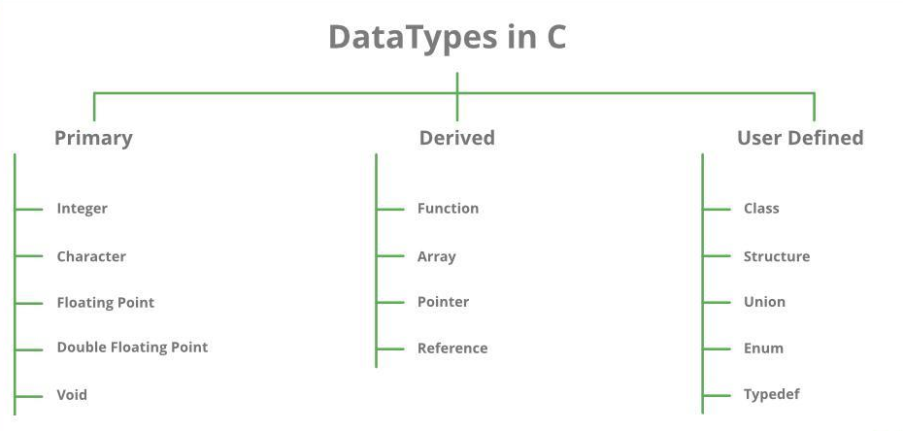
Data Types
03
/18

Slide 5
Data Types
04
/18
A data type is a classification of data which tells the compiler or interpreter how the programmer intends to use the data.
A data type specifies the type of data that a variable can store such as integer, Char, Float.
The data type defines which operations can safely be performed to create, transform and use the variable in another computation.
When a program language requires a variable to only be used in ways that respect its data type, that language is said to be strongly typed.
Although the size of any unsigned as well as the signed data type is all the same, they both possess different ranges of values to be stored in any variable.

Slide 6
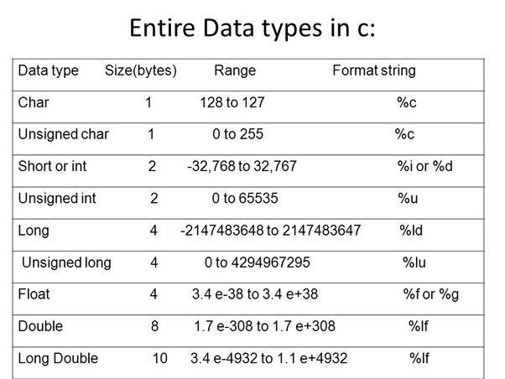
05
/18

Slide 7
Operators
06
/18
Operators are the foundation of any programming language. We can define operators as symbols that help us to perform specific mathematical and logical computations on operands.
In other words, we can say that an operator operates the operands.
Arithmetic Operators
Relational Operators
Logical Operators
Bitwise Operators
Assignment Operators
Other Operators

Slide 8
Operators
07
/18
1. Arithmetic Operators: These operators are used to perform arithmetic/mathematical operations on operands. Examples: (+, -, *, /, %,++,–).
2. Relational Operators: These are used for the comparison of the values of two operands. For example, checking if one operand is equal to the other operand or not, whether an operand is greater than the other operand or not, etc. Some of the relational operators are (==, >= , <= ).
3. Logical Operators: Logical Operators are used to combine two or more conditions/constraints or to complement the evaluation of the original condition in consideration. The result of the operation of a logical operator is a Boolean value either true or false.

Slide 9
Operators
08
/18
4. Bitwise Operators: The Bitwise operators are used to perform bit-level operations on the operands. The operators are first converted to bit-level and then the calculation is performed on the operands.
5. Assignment Operators: Assignment operators are used to assign value to a variable. The left side operand of the assignment operator is a variable and the right side operand of the assignment operator is a value.
6. Other Operators: Apart from the above operators, there are some other operators available in C used to perform some specific tasks.
such like size of operator, Conditional Operators

Slide 10
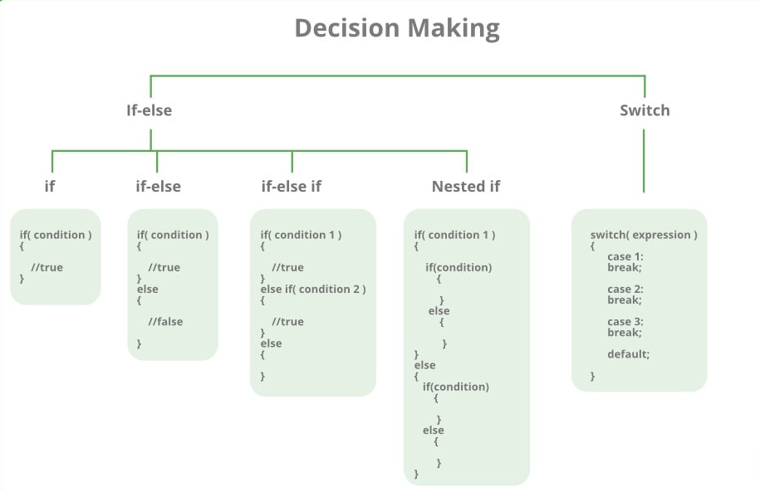
Control Statement
09
/18

Slide 11
Control Statement
10
/18
The Decision Making Statements are used to evaluate the one or more conditions and make the decision whether to execute set of statement or not.
1. if : if statement is the most simple decision-making statement. It is used to decide whether a certain statement or block of statements will be executed or not i.e if a certain condition is true then a block of statement is executed otherwise not.
2. if-else :The if statement alone tells us that if a condition is true it will execute a block of statements and if the condition is false it won’t. But what if we want to do something else if the condition is false.

Slide 12
Control Statement
11
/18
3. nested-if :A nested if in C is an if statement that is the target of another if statement. Nested if statements mean an if statement inside another if statement.
4. if-else-if ladder: Here, a user can decide among multiple options. The C if statements are executed from the top down. As soon as one of the conditions controlling the if is true, the statement associated with that if is executed, and the rest of the C else-if ladder is bypassed.
5.Switch case statement evaluates a given expression and based on the evaluated value(matching a certain condition), it executes the statements associated with it. Basically, it is used to perform different actions based on different conditions(cases).

Slide 13
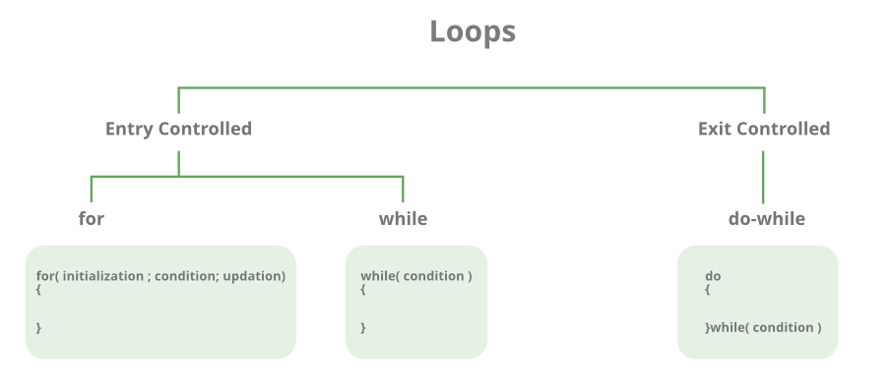
Loops
12
/18
Loops in programming are used to repeat a block of code until the specified condition is met. A loop statement allows programmers to execute a statement or group of statements multiple times without repetition of code.

Slide 14
Loops
13
/18
for Loop :for loop in C programming is a repetition control structure that allows programmers to write a loop that will be executed a specific number of times. for loop enables programmers to perform n number of steps together in a single line.
While Loop: While loop does not depend upon the number of iterations. In for loop the number of iterations was previously known to us but in the While loop, the execution is terminated on the basis of the test condition. If the test condition will become false then it will break from the while loop else body will be executed.

Slide 15
Loops
14
/18
3. do-while Loop: The do-while loop is similar to a while loop but the only difference lies in the do-while loop test condition which is tested at the end of the body. In the do-while loop, the loop body will execute at least once irrespective of the test condition.
initialization_expression;
do
{
// body of do-while loop
update_expression;
} while (test_expression);

Slide 16
Functions
15
/18
Functions are sets of statements that take inputs, perform some operations, and produce results. The operation of a function occurs only when it is called.
Rather than writing the same code for different inputs repeatedly, we can call the function instead of writing the same code over and over again.
Function declarations tell the compiler how many parameters a function takes, what kinds of parameters it returns, and what types of data it takes. Function declarations do not need to include parameter names, but definitions must.

Slide 17
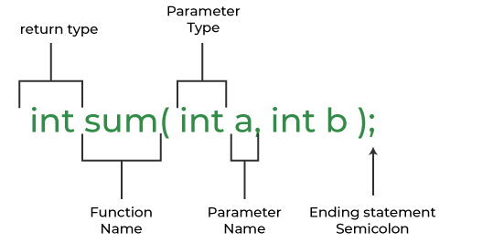
Functions
16
/18

Slide 18
Functions
17
/18
Function Declarations: Function declarations tell the compiler how many parameters a function takes, what kinds of parameters it returns, and what types of data it takes. Function declarations do not need to include parameter names, but definitions must.
The parameters passed to function are called actual parameters whereas the parameters received by function are called formal parameters.
Call By Value: In this parameter passing method, values of actual parameters are copied to function’s formal parameters and the two types of parameters are stored in different memory locations. So any changes made inside functions are not reflected in actual parameters of the caller.

Slide 19
Functions
17
/18
Type of declarations
1.No return type functions(no arguments)
2. with return type functions(with arguments)
3. with return type functions(no arguments)
4.no return type functions(with arguments)

Slide 20
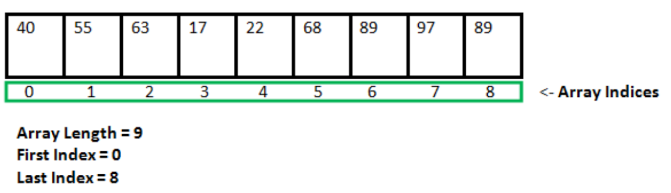
Array
An array in C/C++ or be it in any programming language is a collection of similar data items stored at contiguous memory locations and elements can be accessed randomly using indices of an array.
They can be used to store the collection of primitive data types such as int, float, double, char many more of any particular type. To add to it, an array in C/C++ can store derived data types such as structures, pointers etc. Given below is the picture representation of an array.

Slide 21
Array
Why do we need arrays?
We can use normal variables (v1, v2, v3, ..) when we have a small number of objects, but if we want to store a large number of instances, it becomes difficult to manage them with normal variables. The idea of an array is to represent many instances in one variable.
Advantages:-
Code Optimization: we can retrieve or sort the data efficiently.
Random access: We can get any data located at an index position.
Disadvantages:-
Size Limit: We can store only the fixed size of elements in the array. It doesn’t grow its size at runtime.

Slide 22
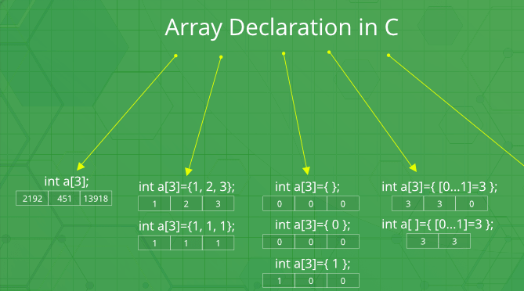
Array

Slide 23
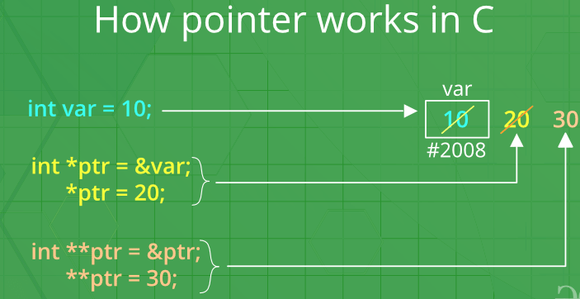
Pointers
Pointers in C are used to store the address of variables or a memory location.
This variable can be of any data type i.e, int, char, function, array, or any other pointer.
The pointer of type void is called Void pointer or Generic pointer.

Slide 24
Pointers
Uses of pointer
To pass arguments by reference
For accessing array elements
To return multiple values
Dynamic memory allocation
To Implement data structures
To do System-Level Programming where memory addresses are useful
To help locating exact value at exact location.
To avoid compiler confusion for same variable name.
To use in Control Tables.

Slide 25
Pointers
Void Pointers:-
A Void Pointer in C can be defined as an address of any variable. It has no standard data type. A void pointer is created by using the keyword void.
NULL Pointers:-
Null pointers can be created by assigning a zero value during pointer declaration. This method is useful when no address is assigned to the pointer.
Pointers can be assigned in 3 ways:-
Address
Null
Zero(0)

Slide 26
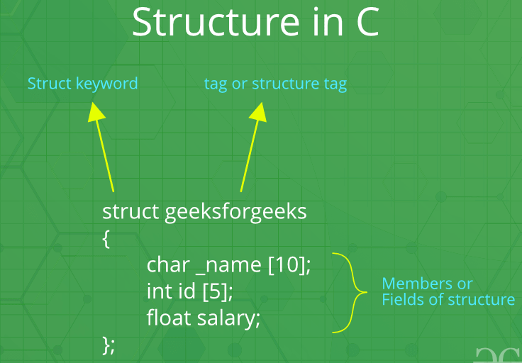
Structures
A structure is a keyword that creates user-defined data types in C.
A structure creates a data type that can be used to group items of possibly different types into a single type.

Slide 27
Structures
Where to use the Structure data type?
We can use this data type to store dates of different attributes of different data types.
For example, If we want to store data on multiple patients such as patient name, age, and blood group.
Why structs in C?
Suppose you want to store information about a person: his/her name, citizenship number, and salary. You can create different variables name, mobNo, and salary to store this information.

Slide 28
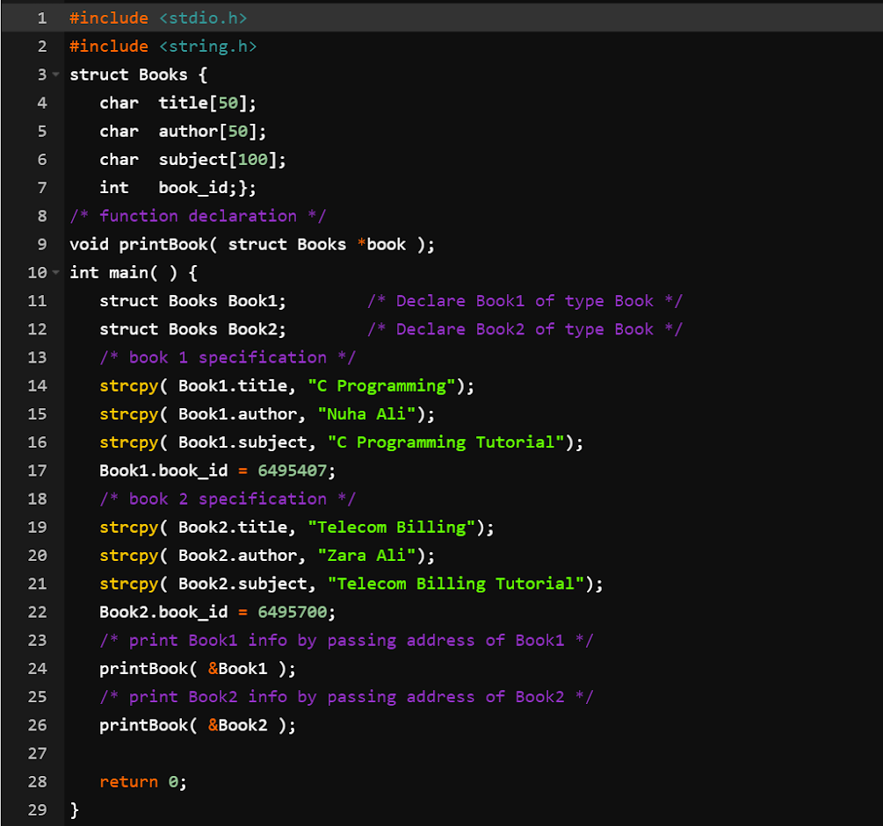
Structures

Slide 29
String
Strings are array of characters i.e. they are arranged one after another in memory. Thus a character array is called string.
Each character within the string is stored within one element of the array successively.
A string is terminated by a null character. (i.e. \0).

Slide 30
String
Strcpy - copy one string into another.
Strcat- append one string onto the right side of the other
Strcmp- compare alphabetic order of two strings
Strlen- return the length of a string
Process of Assigning some legal default data to String is Called Initialization of String.​
A string can be initialized in different ways. We will explain this with the help of an example. ​
Below is an example to declare a string with name as str and initialize

Slide 31
String
Function​ | Purpose​ | Example​ | Output​
Strcpy();​ | Makes a copy of a string​ | strcpy(s1, “Hi”);​ | Copies “Hi” to ‘s1’ variable​
Strcat();​ | Appends a string to the end of another string​ | strcat(“Work”, “Hard”);​ | Prints “WorkHard”​
Strcmp();​ | Compare two strings alphabetically​ | strcmp(“hi”, “bye”);​ | Returns -1.​
Strlen();​ | Returns the number of characters in a string​ | strlen(“Hi”);​ | Returns 2.​
Strrev();​ | reverses a given string​ | Strrev(“Hello”);​ | olleH​
Strlwr();​ | Converts string to lowercase​ | Strlwr(“HELLO”);​ | hello​
Strupr();​ | Converts string to uppercase​ | Strupr(“hello”);​ | HELLO​

Slide 32
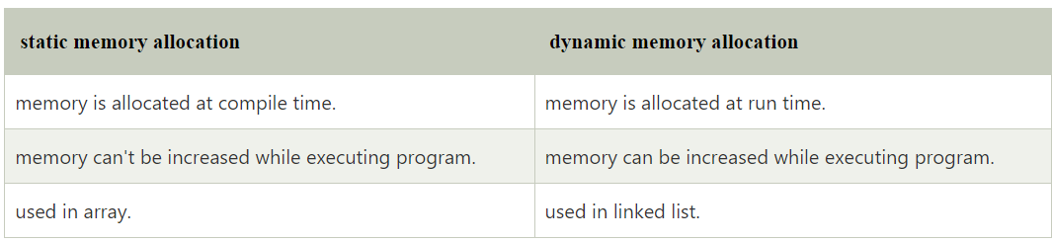
Dynamic Memory Allocation
C is a structured language, it has some fixed rules for programming. One of them includes changing the size of an array.
This procedure is referred to as Dynamic Memory Allocation in C.
The concept of dynamic memory allocation in c language enables the C programmer to allocate memory at runtime. Dynamic memory allocation in c language is possible by 4 functions.
malloc()
calloc()
realloc()
free()

Slide 33
Dynamic Memory Allocation
Malloc()
The name "malloc" stands for memory allocation.The malloc() function reserves a block of memory of the specified number of bytes. And, it returns a pointer of void which can be casted into pointers of any form.
Calloc()
The name "calloc" stands for contiguous allocation.The malloc() function allocates memory and leaves the memory uninitialized, whereas the calloc() function allocates memory and initializes all bits to zero.
Realloc()
If the dynamically allocated memory is insufficient or more than required, you can change the size of previously allocated memory using the realloc() function.
Free()
Dynamically allocated memory created with either calloc() or malloc() doesn't get freed on their own. You must explicitly use free() to release the space.

Slide 34
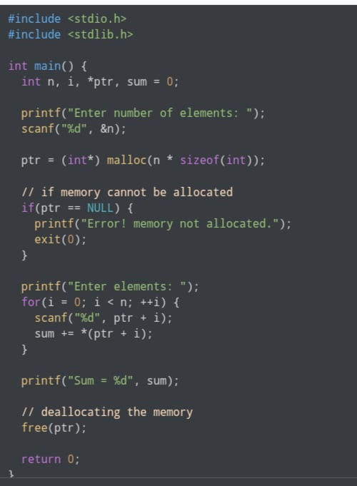
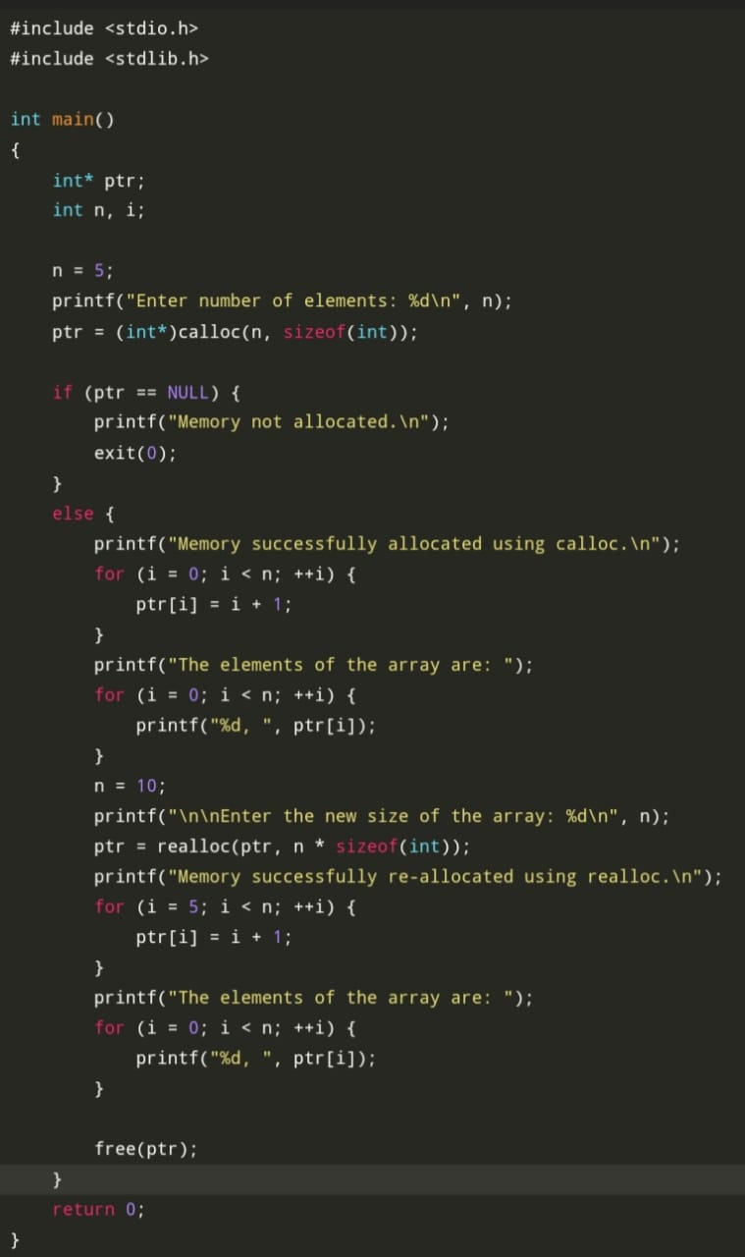
Dynamic Memory Allocation

Slide 35
STRUCTURE
17
/18
A structure is a user-defined data type that can store related information(even of different data type) together.
Declarations
struct structure_name
{
data_type member1;
data_type member2;
.
.
data_type memeberN;
};

Slide 36
STRUCTURE
17
/18
struct structure_name
{
data_type member1;
data_type member2;
.
.
data_type memeberN;
}struct_var = {constant1,constant2,constant3,...}; OR
struct struct_name struct_var = {constant1,constant2,constant3,...};

Slide 37
STRUCTURE
17
/18
In C, there are cases where we need to store multiple attributes of an entity. It is not necessary that an entity has all the information of one type only. It can have different attributes of different data types. For example, an entity Student may have its name (string), roll number (int), marks (float). To store such type of information regarding an entity student, we have the following approaches:
Construct individual arrays for storing names, roll numbers, and marks.
Use a special data structure to store the collection of different data types.

Slide 38
Preprocessors
The C preprocessor is a micro processor that is used by compiler to transform your code before compilation. It is called micro preprocessor because it allows us to add macros.
List of preprocessor directives
#include -> inserts a particular header from another file.
#define ->Substitutes a preprocessor macro.
#undef ->Undefines a preprocessor macro.
#ifdef ->Returns true if this macro is defined.
#ifndef->Returns true if this macro is not defined.
#if ->Tests if a compile time condition is true.
#else ->The alternative for #if.
#elif ->if else and #if in one statement.
#endif ->Ends preprocessor conditional.
#error ->Prints error message on stderr.
#pragma ->Issues special commands to the compiler, using a standardized method.

Slide 39
Preprocessors
Predefined Macros
1 __DATE__
The current date as a character literal in "MMM DD YYYY" format.
2 __TIME__
The current time as a character literal in "HH:MM:SS" format.
3 __FILE__
This contains the current filename as a string literal.
4 __LINE__
This contains the current line number as a decimal constant.
5 __STDC__
Defined as 1 when the compiler complies with the ANSI standard.
Preprocessor Operator
Macro Continuation (\)
A macro is normally confined to a single line. The macro continuation operator (\) is used to continue a macro that is too long for a single line
ex:-#define message_for(a, b) \
printf(#a " and " #b ": We love you!\n")
The Stringize Operator (#)
The stringize or number-sign operator ( '#' ), when used within a macro definition, converts a macro parameter into a string constant. This operator may be used only in a macro having a specified argument or parameter list
ex:- #include <stdio.h>
#define message_for(a, b) \
printf(#a " and " #b ": We love you!\n")
int main(void) {
message_for(Carole, Debra);
return 0;
The token Passing Operator (##)
The token-pasting operator (##) within a macro definition combines two arguments. It permits two separate tokens in the macro definition to be joined into a single token
ex:- #include <stdio.h>
#define tokenpaster(n) printf ("token" #n " = %d", token##n)
int main(void) {
int token34 = 40;
tokenpaster(34);
return 0;

Slide 40
Examples
1.
#include <stdio.h>
// macro with parameter
#define AREA(l, b) (l * b)
int main()
{
int l1 = 10, l2 = 5, area;
area = AREA(l1, l2);
printf("Area of rectangle is: %d", area);
return 0;
2.
#include <stdio.h>
main() {
printf("File :%s\n", __FILE__ );
printf("Date :%s\n", __DATE__ );
printf("Time :%s\n", __TIME__ );
printf("Line :%d\n", __LINE__ );
printf("ANSI :%d\n", __STDC__ );
}
3.
#include <stdio.h>
// macro definition
#define LIMIT 5
int main()
{
for (int i = 0; i < LIMIT; i++) {
printf("%d \n",i);
}
return 0;
}
4.
#include <stdio.h>
#if !defined (MESSAGE)
#define MESSAGE "You wish!"
#endif
int main(void) {
printf("Here is the message: %s\n", MESSAGE);
return 0;
}

Slide 41
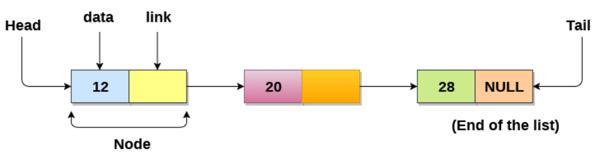
Linked List
1.A linked list is a sequence of data structures, which are connected together via links. Linked List is a sequence of links which contains items. Each link contains a connection to another link. Linked list is the second most-used data structure after array.
2.A node contains two fields i.e. data stored at that particular address and the pointer which contains the address of the next node in the memory
The last node of the list contains pointer to the null

Slide 42
Linked List
Types Of Linked List:-
Simple Linked List – In this type of linked list, one can move or traverse the linked list in only one direction. where the next pointer of each node points to other nodes but the next pointer of the last node points to NULL. It is also called “Singly Linked List”.
Doubly Linked List – In this type of linked list, one can move or traverse the linked list in both directions (Forward and Backward)
Circular Linked List – In this type of linked list, the last node of the linked list contains the link of the first/head node of the linked list in its next pointer.
Doubly Circular Linked List – A Doubly Circular linked list or a circular two-way linked list is a more complex type of linked list that contains a pointer to the next as well as the previous node in the sequence. The difference between the doubly linked and circular doubly list is the same as that between a singly linked list and a circular linked list. The circular doubly linked list does not contain null in the previous field of the first node.

Slide 43
Linked List
#include<stdio.h>
#include<stdlib.h>
struct node{
int data;
struct node *next;
};
int main(){
struct node* newnode,*temp,*head;
int con=1;
head=NULL;
while(con==1){
newnode=(struct node*)malloc(sizeof(struct node));
printf("enter the data\n");
scanf("%d",&newnode->data);
newnode->next=0;
if (head==NULL){
head=temp=newnode;
}
else{
temp->next=newnode;
temp=newnode;
}
printf("if you want to Continue Enter 1\n");
scanf("%d",&con);
}
temp=head;
int count=0,pos;
printf("Enter the position You want to enter\n");
scanf("%d",&pos);
if(pos==1){
newnode=(struct node*)malloc(sizeof(struct node));
scanf("%d",&newnode->data);
newnode->next=head;
}
else{
while(count<pos-2){
temp=temp->next;
count++;
}
newnode=(struct node*)malloc(sizeof(struct node));
printf("Enter the new node data");
scanf("%d",&newnode->data);
newnode->next=temp->next;
temp->next=newnode;
}
temp=head;
while (temp!=NULL)
{
printf("%d\n",temp->data);
temp=temp->next;
}
}

Slide 44


